Slide 1
Annual Meeting
November 4, 2018

Slide 2
Acknowledgements
Thank you for coming tonight and for the support you have provided during the past year

Slide 3
2018 TRF Board Members
Carole Arco
Eric Balthasar
Juanita Berdis
John Berka
Pete Croner
(Treasurer)
Judi Ekola
Brandon Epting
Dawn Koenig (Vice Chair)
Tom Lewis
Theresa Mittelbrun (Secretary)
Pastor Mueller Jr. (President)
Tom Ostrander
Peg Siems
Andy Trosper (Chairman)
Connor Vance (non-voting)

Slide 4
2018/19 TRF Board Changes
Juanita Berdis completed her service term in FY 2018.
Juanita served for a period of 7 years.
Carole Arco is now serving as Treasurer relieving Pete Croner.
Pete acted as Treasurer for four years and remains on the board.
The board acknowledges their contributions and thanks them for their service.

Slide 5
Agenda
Purpose
FY2018 Financial Review
Marketing Review
Activity & Support
LCMS Foundation Partnership
Gift Designation & Allocation

Slide 6
Purpose

Slide 7
Purpose
To provide encouragement and develop gifts that strengthen the mission of Trinity Lutheran Church and School in Roselle, Illinois
To help accomplish its mission in our time and for generations to come

Slide 8
Purpose
To provide funds to ministries outside of Trinity that advance the mission of Trinity Lutheran Church
To provide gifts in TRF Funds or create an Endowment in accordance with the TRF Gift Acceptance Policy

Slide 9
TRF Current Funds
Current Funds include:
General Fund
School Endowment Fund
School Tuition Fund
Church Endowment Fund
Prange Mueller Fund

Slide 10
FY2018 Financial Review

Slide 11
FY2018 Financial Review
Vanguard Investment Performance
Annualized Return (7/1/17 – 6/30/18) of +8.9% (previous year +12.2%)
Index Returns: DOW + 13.7%; S&P + 12.2%
Asset Diversification & Lower management Fees
Total Net Assets at June 30, 2018 $1,813,264
Vanguard annual return since inception - 9.0%

Slide 12
FY2018 Financial Review
Receipts Totaled $30,926
Fund Earnings Totaled $114,037
Grants Given Out Totaled $70,500

Slide 13
FY2018 Financial Review
Total Fund Balances at June 30th - $1,813,264
General Foundation - $300,370
School Endowment Fund - $654,714
School Tuition Fund - $356,321
Church Endowment Fund - $452,174
Prange Mueller/Other Funds -$49,685

Slide 14
Marketing Review

Slide 15
2018 TRF Theme
Raising Awareness on TRF Engagement
Continuity of Programs
Higher Profile on Social Media
Drive Affinity within the Church and School

Slide 16
Summary
Goals
Key Messages
Key Audiences
2018 Strategies
Awareness Calendar
Social Media

Slide 17
Goals
Raise Overall Awareness of Foundation
Grow depth of familiarity
Increase “giving” from current givers
Drive “giving” from new prospects
Announce Estate Planning Consulting
Develop a Congregational Gift Planner

Slide 18
Key Messages
Explanation about the Foundation and how it serves all members of Trinity and the community beyond
Trinity partners checking on retirement-aged church partners regarding their estate planning
We have LCMS estate planning consultants to assist members
Free service to assist in development of a unique plan for estate planning
Consider adding Trinity Lutheran Church as a beneficiary to their estate

Slide 19
Key Audiences
Primary
Adults
55+
Active Trinity Members

Slide 20
2018 Strategies
Build Awareness
Relational Outreach
Estate Planning Advocacy
Giving Forward Commitments

Slide 21
2018 Awareness Calendar
Tactics | Jan | Feb | Mar | Apr | May | June | July | Aug | Sept | Oct | Nov | Dec
411 | 2 | 2 | 1 |  |  |  | 2 |  | 2 | 2 | 1 | 1
Take-Out | 2 | 2 | 2 |  | 1 |  |  |  |  |  | Message | Message
The City | Banner | Banner | Banner |  |  |  |  |  |  |  | Banner | Banner
Blogs | Post Blog on TRF Site |  | Post Blog on TRF Site |  |  |  |  |  |  |  | Post Blog on TRF Site
Email Blasts | 1 | 1 |  |  |  |  |  |  |  |  | 1
Hand Outs | 1 | 6 | 1 |  |  |  |  |  |  |  | 2
Principals Corners | 2 issues | 2 issues | 2 issues |  | 1 issue
Sponsorships & Drives | Financial Peace Seminars | Wills, Trusts, POA Session Black History Month | Grand Parents Day Young Investor Fund Match $25 |  | Young Investors Fund to School-Match $25 |  |  |  |  |  | Annual Meeting Outreach Drive Wills, Trusts Seminar | Outreach Drive

Slide 22
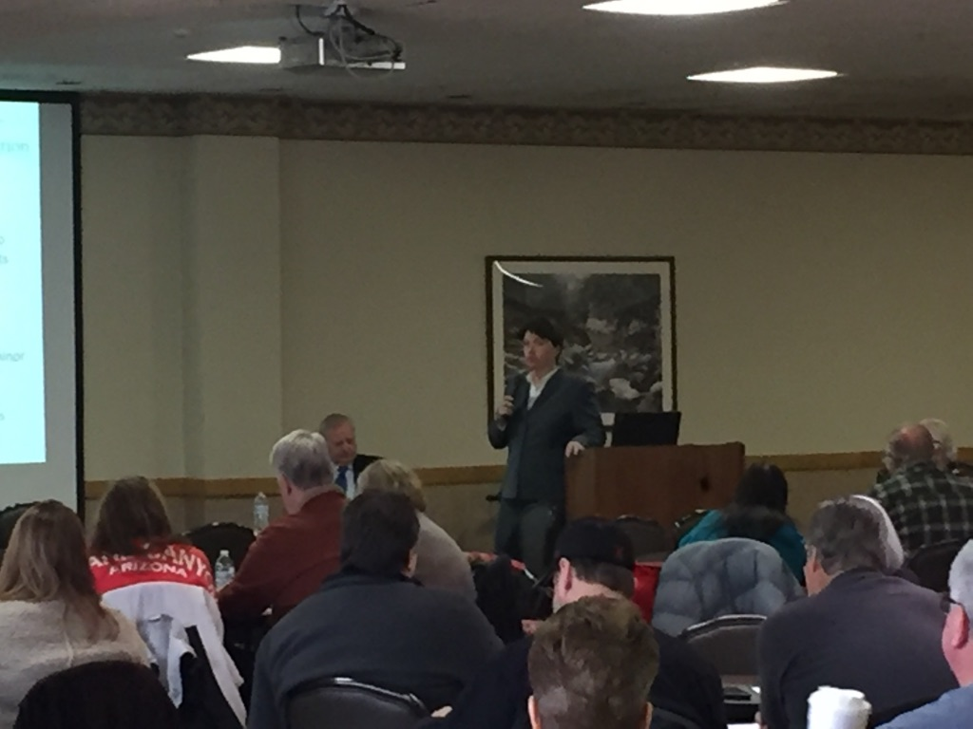
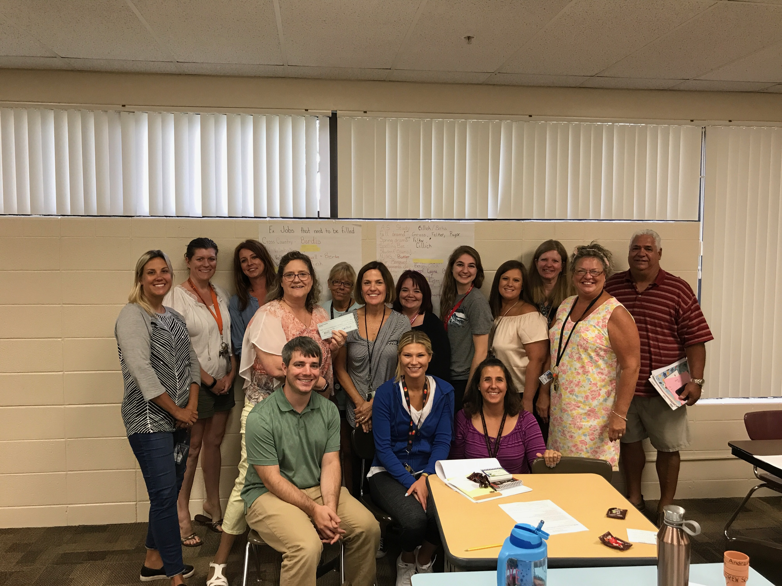
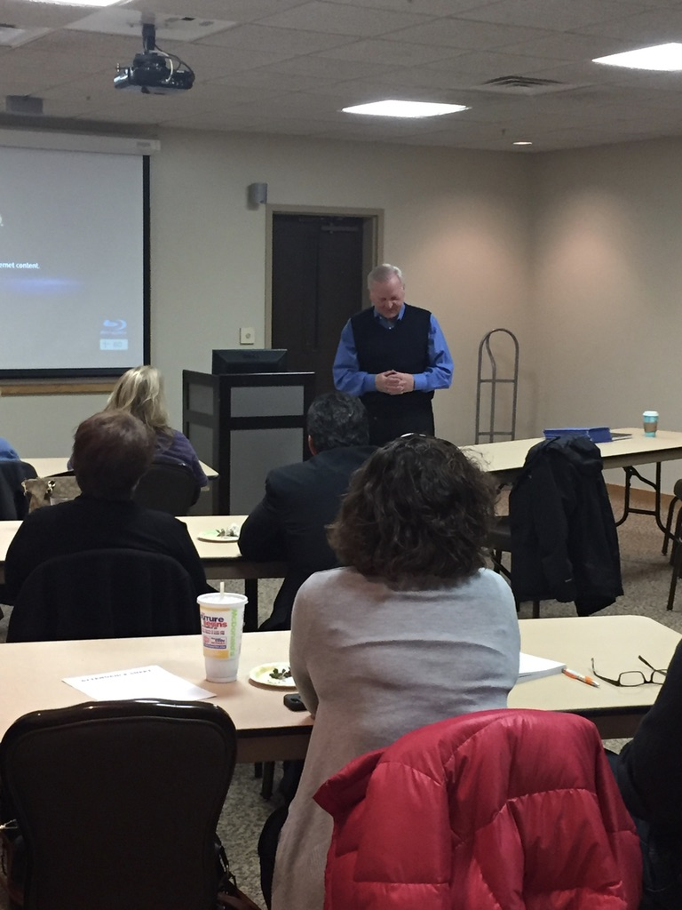
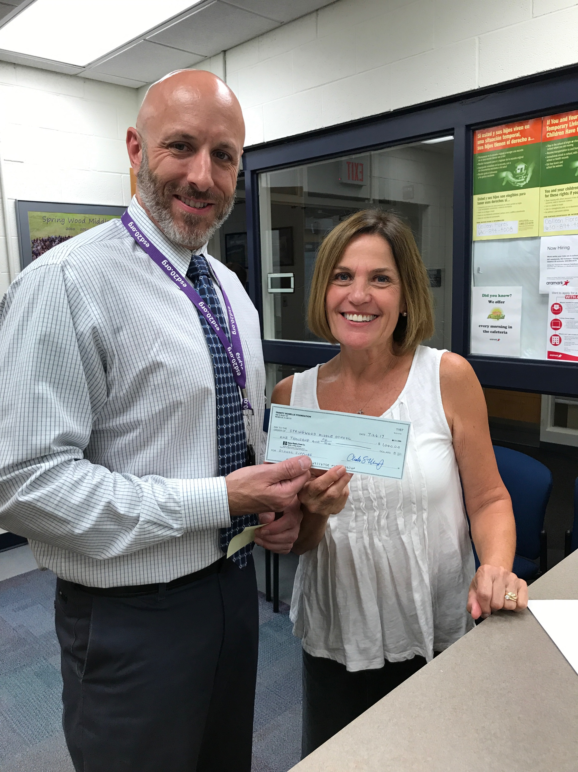

Slide 23
2019 Awareness Calendar Preliminary
Tactics | Jan | Feb | Mar | Apr | May | Jun | Jul | Aug | Sep | Oct | Nov | Dec
411 | XX |  | XX |  | XX |  | XX |  | XX |  | XX
Take-Out |  | XX |  | XX |  | XX |  | XX |  | XX
The City | XX |  | XX |  | XX |  | XX |  | XX |  | XX
Blog | XX |  | XX |  | XX |  |  |  | XX |  |  | XX
Email Blasts |  | XX |  |  |  | XX |  |  | XX |  | XX
Direct Mail |  |  | XX |  |  |  |  | XX
Sponsorships & Drives | Financial Peace Outreach Drive | Outreach Drive | Young Investor / Grand Parents Day Outreach Drive | Wills, Trusts Seminar Outreach Drive |  |  |  | XX |  | XX

Slide 24
Social Media
Website redesigned and optimized to:
Make it more user friendly
Reprioritize the information on the site
Explain various funds and other ways to donate
Easily update content like blogs, activities and news
Make it possible to easily donate online
http://trinity-roselle-foundation.com
Facebook page established (please like us!)
Blogs written to communicate activities

Slide 25
Activity & Support

Slide 26
FY2018 Foundation Activity
Grants For the Year Totaled $70,500
$20,000 - School Grant-in-Aid
$23,000 – School Technology Upgrades/Training
$8,100 - School Tuition Assistance
$6,000 – School Supplies
$13,400 – Other Miscellaneous

Slide 27
FY2019 Foundation Activity
Grants Awarded in the New Fiscal Year
$12,000 – School Technology/Security
$11,000 – School Grant-in-aid
$9,300 – School Tuition Assistance
$5,000 – School Faculty Training
$2,000 – Parent Workshops

Slide 28
2018 Foundation Support
School Grant-in-aid fund
Assistance requested to provide families in need to support their efforts. In 2018, 16 families received assistance
Goal to allow every student who wants to attend Trinity Lutheran School to be financially able to do so

Slide 29
Summary of TRF/LCMS Foundation Activity (3-years)
Date | Ministry Gifts | Trinity Gifts | Comments | # of Gifts
July 2015- June 2016 | $150,000 | $465,735 | Plans completed with attorney | 1
July 2015- June 2016 | $474,003 | $474,003 | Givers w/ verbally acknowledged gift, amount estimated | 3
July 2016- June 2017 | $402,084 | $484,084 | Plans completed with attorney | 5
July 2016- June 2017 | $125,499 | $125,499 | Givers w/verbally acknowledged gift, amount estimated | 1
July 2017- June 2018 | $0 | $141,866. | Plans completed with attorney | 3
July 2017- June 2018 | $0 | $0 | Givers w/verbally acknowledged gift, amount estimated | 0

Slide 30
Total Gifts Acknowledged by TRF/LCMS Foundation 2008-2018
Total Disclosed Gifts | $6,622,332.
# of Undisclosed Gifts | 25
Estimated Value of Undisclosed Gifts | $2,945,466
Total Gift Value (Disclosed + Undisclosed) | $9,567,798

Slide 31
TRF Partnership with LCMS Foundation

Slide 32
Ray Pagels – LCMS Foundation
An experienced Christian Gift Planning Counselor
Works with 5 churches in the area
Trained by and works for LCMS Foundation
Confidential/Free advisor to assist members in estate planning to transfer blessings
Member of St. Peter, Arlington Heights

Slide 33
Ray Pagels – LCMS Foundation
TRF pays LCMS Foundation $5,000 per year for Ray’s services
LCMS Foundation reimburses him his expenses
LCMS Foundation relocated office at Trinity to St. Peter Arlington Heights in 2017
Trinity is extremely appreciative for Ray, and LCMS Foundation and their services and support

Slide 34
Designated and Undesignated Gifts

Slide 35
Designated Gifts
School
Endowment
Fund
School
Tuition Endowment Fund
Church
Endowment
Fund
Charles S.
& Audrey
Prange Mueller
Endowment
Fund
General
Fund
The purpose of this fund is to reduce the costs associated with the School, thereby, reducing tuition
The purpose of this fund is to reduce the net tuition charged to ALL Students
The purpose
of this fund is to provide future preservation and expansion of the church and to assist in funding future costs
The purpose
of this fund is to provide grants for church workers and expansion of outreach ministries
These are funds
For general
purposes
and require
Board approval

Slide 36
Undesignated Gifts
General Foundation Fund
All gifts received without a designation from the donor will be placed in this fund
Distribution from this fund
40%
Church Endowment Fund
20%
School Endowment Fund
20%
School Tuition Endowment Fund
20%
As Designated by TRF Board

Slide 37
The Eternity Circle

Slide 38
Eternity Circle Awards
Award given to Trinity Members and TRF supporters who have completed a gift plan and acknowledged it to TRF & LCMF.

Slide 39
Thank You
Thank you for honoring HIS ministry above and beyond your normal gifts to support Trinity
Does anyone have any questions?
Please enjoy yourself with food, drink and conversation with fellow foundation contributors and board members

Slide 40
Thank You!

