Slide 1
Annual Meeting
November 19, 2017

Slide 2
Acknowledgements
Thank you for coming tonight and for the support you have provided during the past year

Slide 3
2017 TRF Board Members
Eric Balthasar
Juanita Berdis
John Berka
Pete Croner (Treasurer)
Judy Ekola
Rick Herman
Dawn Koenig (Vice Chairman)
Tom Lewis
Theresa Mittelbrun (Secretary)
Pastor Mueller Jr. (President)
Tom Ostrander
Andy Trosper (Chairman)
Connor Vance (non-voting)

Slide 4
Agenda
Purpose
Financial Review
2017 Marketing Plan & Calendar
TRF Social Media
Activity & Support
Giving Recap
Eternity Circle Awards

Slide 5
Purpose

Slide 6
Purpose
To provide encouragement and develop gifts that strengthen the mission of Trinity Lutheran Church and School in Roselle, Illinois
To help accomplish its mission in our time and for generations to come

Slide 7
Purpose
To provide funds to ministries outside of Trinity that advance the mission of Trinity Lutheran Church
To provide gifts in TRF Funds or create an Endowment in accordance with the TRF Gift Acceptance Policy

Slide 8
TRF Current Funds
Current Funds include:
General Fund
School Endowment Fund
School Tuition Fund
Church Endowment Fund
Prange Mueller Fund

Slide 9
2017 Financial Highlights

Slide 10
2017 Financial Highlights
Vanguard Investment Performance
Annualized Return (7/1/16 – 6/30/17) of +12.2% (previous year +4.8%)
Index Returns: DOW + 19.1%; S&P + 15.4%
Asset Diversification & Lower management Fees
Total Net Assets at June 30, 2017 $1,754,481
Since inception Vanguard annual return 9.2%

Slide 11
2017 Financial Highlights
Receipts Totaled $17,206
Fund Earnings Totaled $191,480
Grants Given Out Totaled $74,490

Slide 12
2017 Financial Highlights
Total Fund Balances at June 30th - $1,754,481
General Foundation - $299,070
School Endowment Fund - $640,657
School Tuition Fund - $334,453
Church Endowment Fund - $436,802
Prange Mueller/Other Funds -$43,499

Slide 13
2017 Marketing Highlights

Slide 14
2017 TRF Theme
Raising Awareness on TRF Engagement
Continuity of Programs
Higher Profile on Social Media
Drive Affinity within the Church and School

Slide 15
Summary
Opportunities
Goals
Messages
Targets
Strategies
Calendar

Slide 16
Key Opportunities
Heighten the role and value of the Foundation
Broaden venues to reach prospects
Focus on the primary target of 55+
Develop annual marketing plan for 2018 to address opportunities

Slide 17
2017 Goals
Raise Overall Awareness of Foundation
Grow depth of familiarity
Increase “giving” from current givers
Drive “giving” from new prospects
Announce Estate Planning Consulting

Slide 18
Key Messages
Explanation about the Foundation and how it serves all members of Trinity and the community beyond
Trinity partners checking on retirement-aged church partners regarding their estate planning
We have LCMS estate planning consultants to assist members
Free service to assist in development of a unique plan for estate planning
Consider adding Trinity Lutheran Church as a beneficiary to their estate

Slide 19
Key Targets
Primary
Adults
55+
Current Trinity Members
Secondary
Adults
35-54
Current Trinity Members

Slide 20
2017 Strategies
Build Awareness
Relational Outreach
Estate Planning Advocacy
Giving Forward Commitments

Slide 21
Awareness Calendar

Slide 22
2017 TRF Calendar
Tactics | Jan | Feb | Mar | Apr | May | June | July | Aug | Sept | Oct | Nov | Dec
411 | 2 | 2 | 1 |  |  |  | 2 |  | 2 | 2 |  | 1
Take-Out | 2 | 2 | 2 |  | 1 |  |  |  |  | Message |  | Message
The City | Banner | Banner | Banner |  |  |  | Banner | Banner | Banner | Banner |  | Banner
Blogs | Post Blog on TRF Site |  | Post Blog on TRF Site |  |  |  |  |  |  | Post Blog on TRF Site |  | Post Blog on TRF Site
Email Blasts | 1 | 1 |  |  |  |  |  |  |  | 1 Blast
Hand Outs | 1 | 6 | 1
Principals Corners | 2 issues | 2 issues | 2 issues |  | 1 issue |  |  |  |  | 1 Issue
Sponsorships & Drives | Financial Peace Seminars | Wills, Trusts, POA Session Black History Month | Grand Parents Day -Young Investor Fund Match $25 | Easter Egg Hunt | Young Investors Fund to School-Match $25 |  | School Supplies Distribute to 5 schools (Community Outreach) |  |  | Give Forward Workshop w Pagels (50+) Re-schedule | Annual Meeting Bullying Asembly | Toy Store

Slide 23
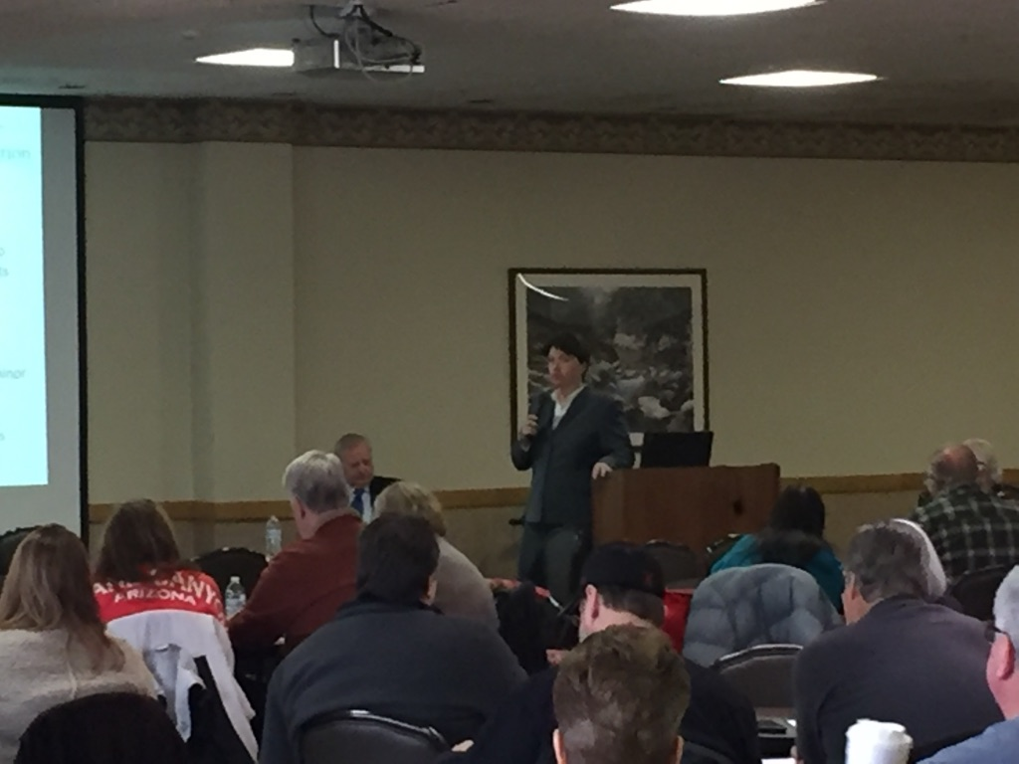
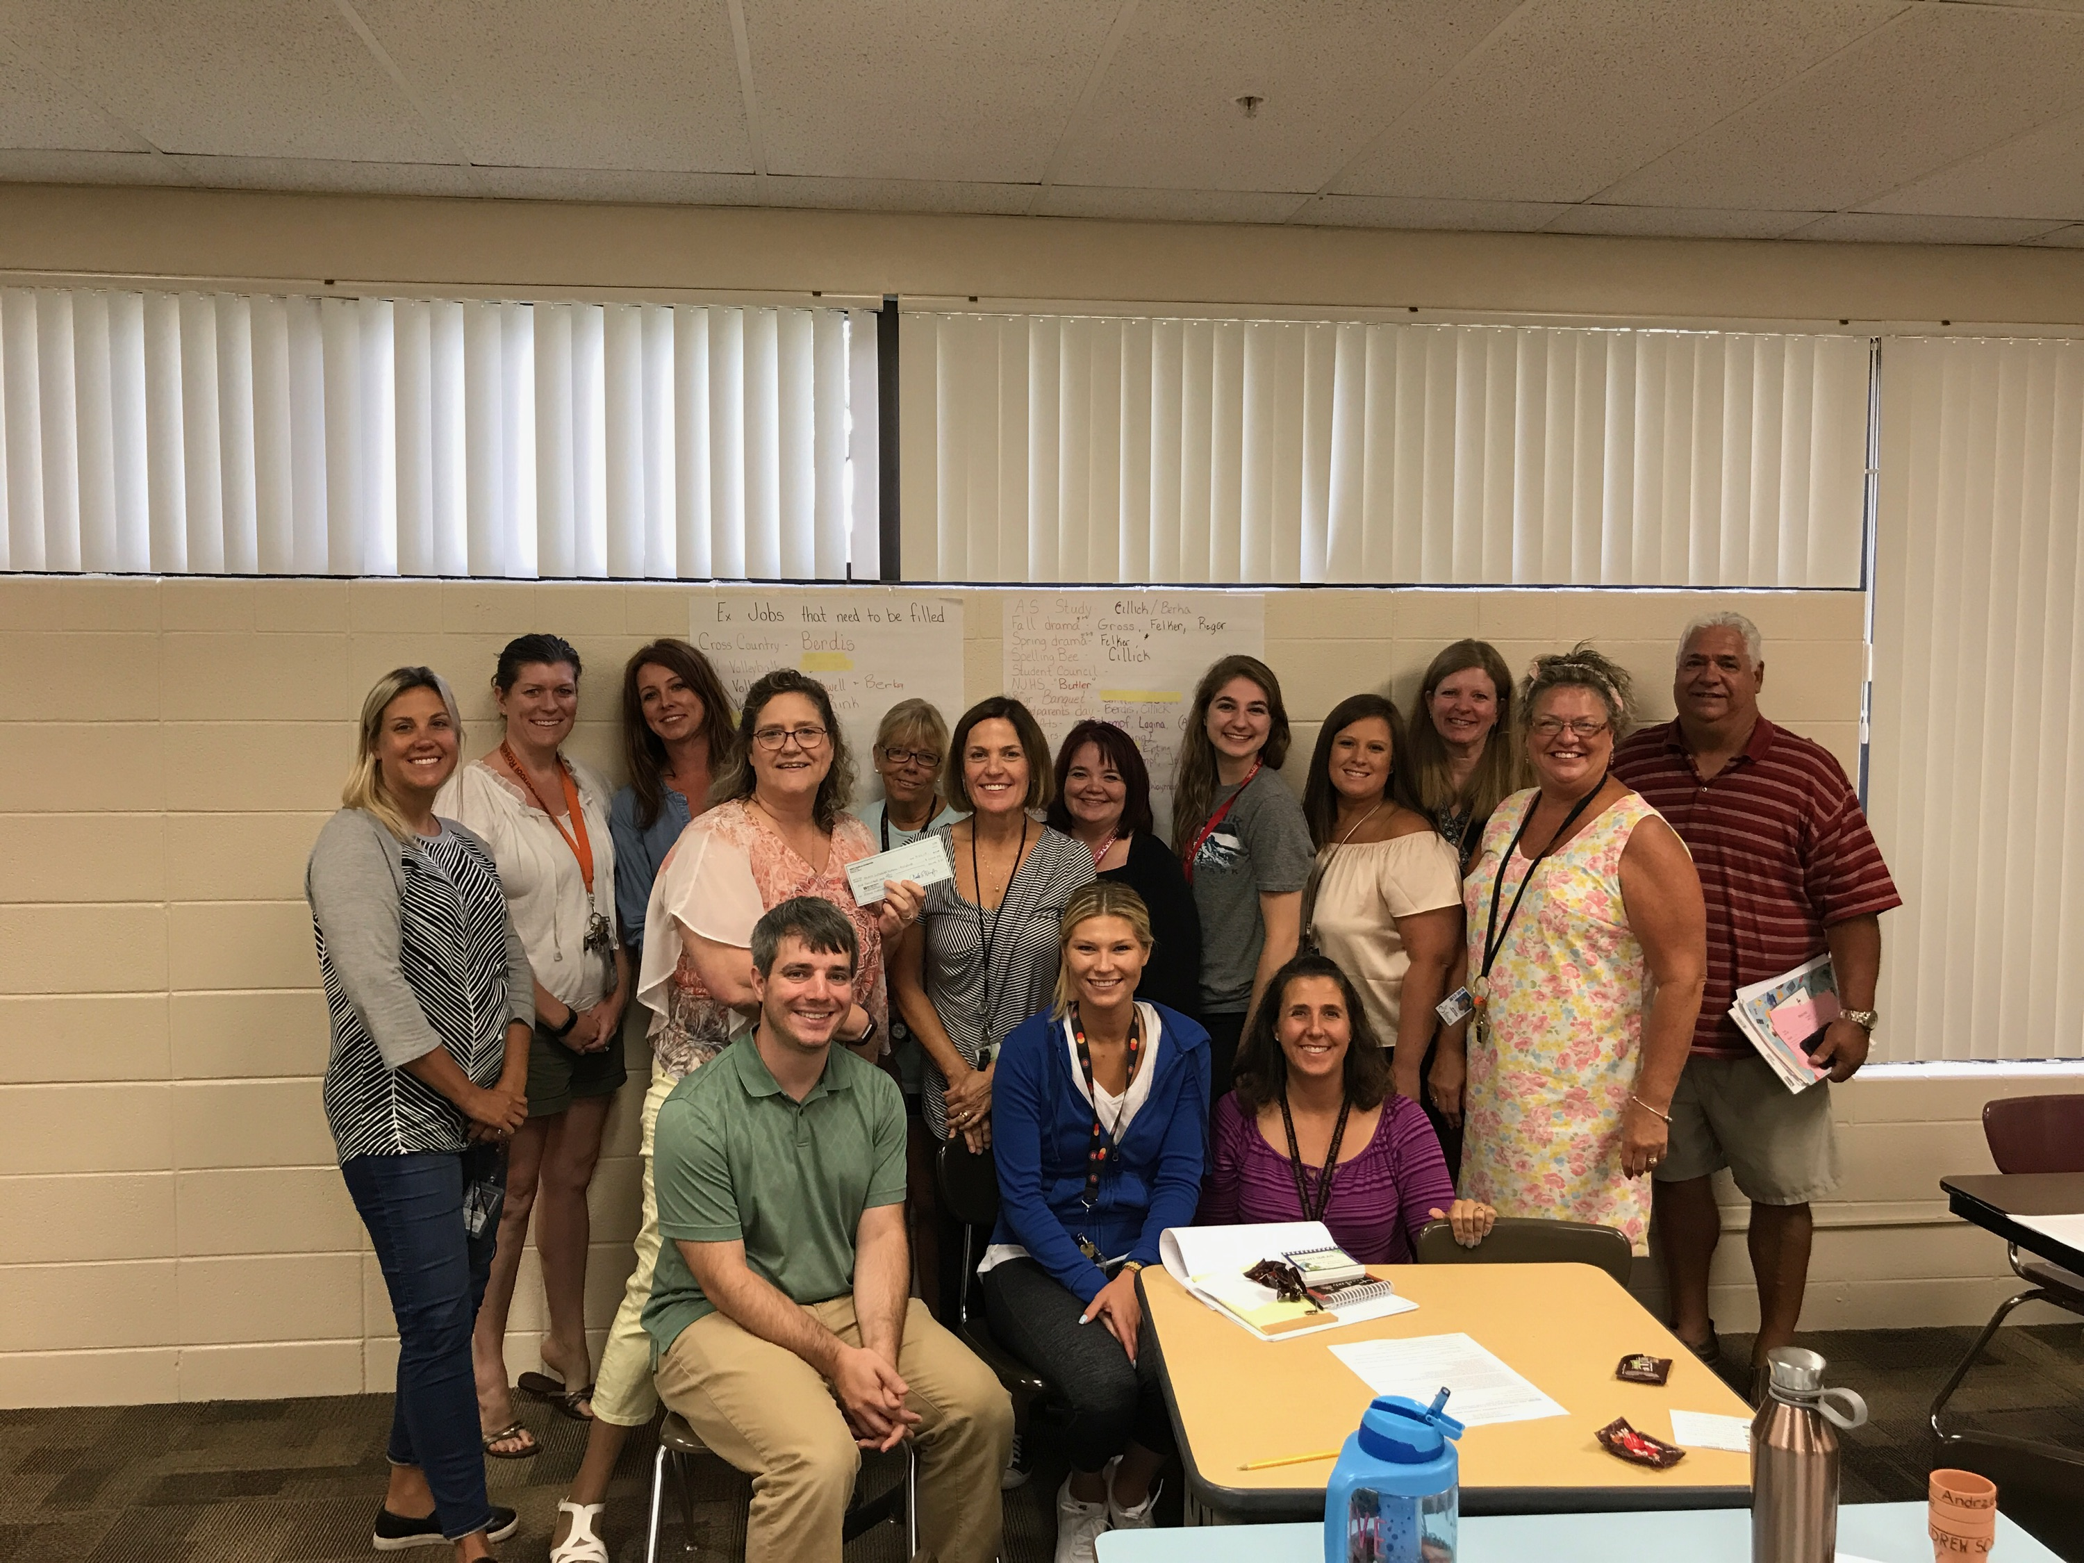
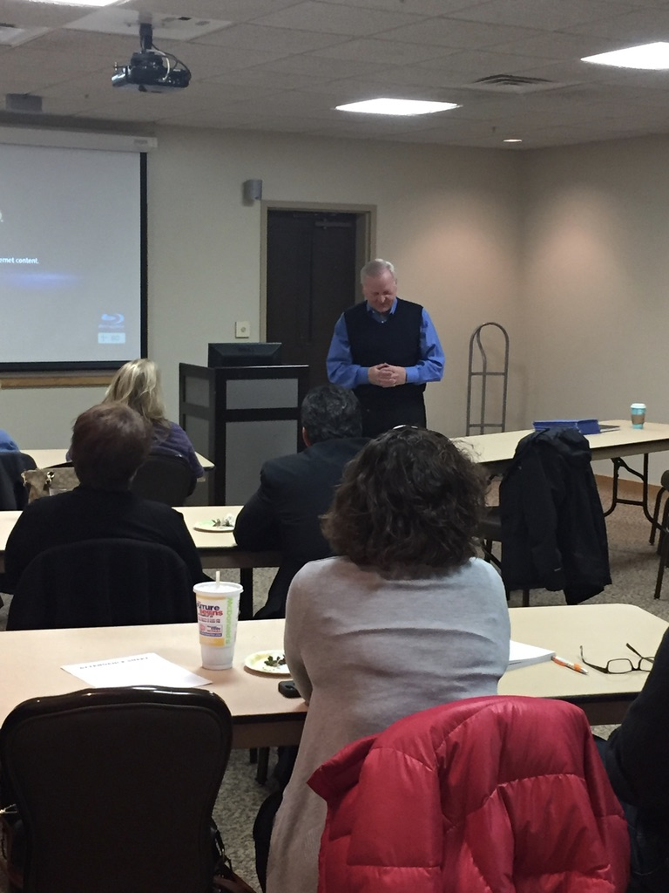
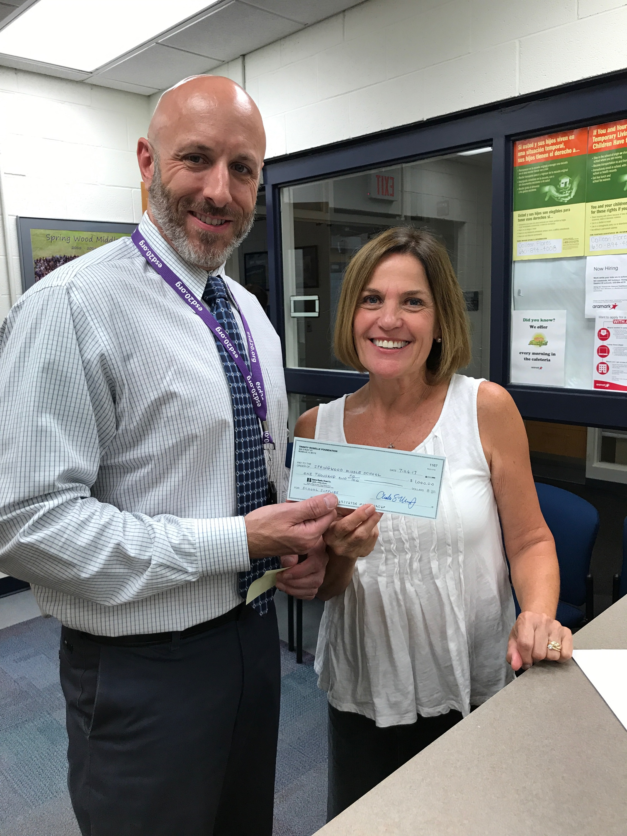

Slide 24
2018 TRF Calendar Preliminary
Tactics | Jan | Feb | Mar | Apr | May | Jun | Jul | Aug | Sep | Oct | Nov | Dec
411 | XX |  | XX |  | XX |  | XX |  | XX |  | XX
Take-Out |  | XX |  | XX |  | XX |  | XX |  | XX
The City | XX |  | XX |  | XX |  | XX |  | XX |  | XX
Blog |  |  | XX |  | XX |  |  |  | XX |  |  | XX
Email Blasts |  | XX |  |  |  | XX |  |  | XX |  | XX
Direct Mail |  |  | XX |  |  |  |  | XX
Website Optimization & Presence
Sponsorships & Drives | Financial Peace | Wills, Trusts & POA’s | Young Investor / Grandparents | XX |  |  |  | XX |  | XX

Slide 25
Social Media

Slide 26
TRF Website & Social Media
Website redone during 2016, redesigned and optimized to:
Make it more user friendly
Reprioritize the information on the site
Explain various funds and other ways to donate
Easily update content like blogs, activities and news
Make it possible to easily donate online
http://trinity-roselle-foundation.com
Facebook page established (please like us!)
Blogs written to communicate activities

Slide 28
Activities & Support

Slide 29
FY2017 Foundation Activity (7/1/16-6/30/17)
Grants For the Year Totaled $74,490
$36,000 - School Grant-in-Aid
$8,290 – Fiber Optic Upgrade and School Curriculum Training
$8,700 - School Tuition Assistance
$13,000 – School Supplies
$8,500 – Other Miscellaneous

Slide 30
FY 2018 Foundation Activity & Support
Grants Awarded in the New Fiscal Year (7/1/17-6/30/18)
$20,000 – School Grant-in-Aid
$8,100 – School Tuition Assistance
$10,000 – School Faculty Training
$8,000 – School Parent Workshops
$5,000 – Technology Upgrades

Slide 31
2017 Foundation Support
School Grant-in-aid fund
Assistance requested to provide families in need to support their efforts. In 2017, 16 families received assistance
Goal to allow every student who wants to attend Trinity Lutheran School to be financially able to do so

Slide 32
2017 Summary of TRF/LCMS Foundation Activities (3-years)
Date | Ministry Gifts | Trinity Gifts | Comments | # of Gifts
July 2014- June 2015 | $545,240 | $465,735 | Plans completed with attorney | 3
July 2014- June 2015 | $715,352 | $715,352 | Givers w/ verbally acknowledged gift, amount estimated | 7
July 2015- June 2016 | $150,000 | $50,000 | Plans completed with attorney | 1
July 2015- June 2016 | $474,003 | $474,003 | Givers w/verbally acknowledged gift, amount estimated | 3
July 2016- June 2017 | $402,084 | $484,084 | Plans completed with attorney | 5
July 2016- June 2017 | $125,499 | $125,499 | Givers w/verbally acknowledged gift, amount estimated | 1

Slide 33
Total Gifts Acknowledged by TRF/LCMS Foundation 2008-2017
Total Disclosed Gifts | $6,480,466
# of Undisclosed Gifts | 25
Estimated Value of Undisclosed Gifts | $2,945,466
Total Gift Value (Disclosed + Undisclosed) | $9,426,132

Slide 34
TRF Partnership with

Slide 35
Ray Pagels – LCMS Foundation
An experienced Christian Gift Planning Counselor
Works with 5 churches in the area
Trained by and works for LCMS Foundation
Confidential/Free advisor to assist members in estate planning to transfer blessings
Member of St. Peter, Arlington Heights

Slide 36
Ray Pagels – LCMS Foundation
TRF pays LCMS Foundation $5,000 per year for Ray’s services
LCMS Foundation reimburses him his expenses
LCMS Foundation closed office at Trinity in 2017
Trinity is extremely appreciative for Ray, and LCMS Foundation and their services and support

Slide 37
Designated and Undesignated Gifts

Slide 38
Designated Gifts
School
Endowment
Fund
School
Tuition Endowment Fund
Church
Endowment
Fund
Charles S.
& Audrey
Prange Mueller
Endowment
Fund
General
Fund
The purpose of this fund is to reduce the costs associated with the School, thereby, reducing tuition
The purpose of this fund is to reduce the net tuition charged to ALL Students
The purpose
of this fund is to provide future preservation and expansion of the church and to assist in funding future costs
The purpose
of this fund is to provide grants for church workers and expansion of outreach ministries
These are funds
For general
purposes
and require
Board approval

Slide 39
Undesignated Gifts
General Foundation Fund
All gifts received without a designation from the donor will be placed in this fund
Distribution from this fund
40%
Church Endowment Fund
20%
School Endowment Fund
20%
School Tuition Endowment Fund
20%
As Designated by TRF Board

Slide 40
The Eternity Circle

Slide 41
2017 Eternity Circle Awards
No New Eternity Circle members this year.

Slide 42
Thank You
Thank you for honoring HIS ministry above and beyond your normal gifts to support Trinity
Does anyone have any questions?
Please enjoy yourself with food, drink and conversation with fellow foundation contributors and board members

Slide 43
Thank You!

